Slide 1
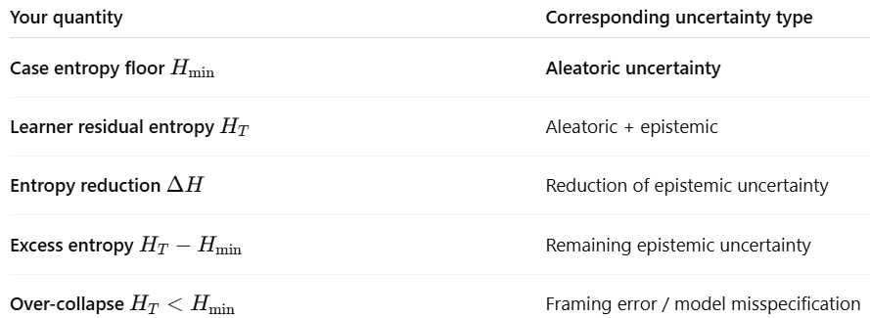


Types of uncertainty: reducible vs irreducible
Learner 1
Learner 2
(Log loss)
(“Aleatoric limit” even with oracle-like knowledge)
Total Epistemic Uncertainty if all key features are captured and accounted for

Slide 2
Log loss is a quantitative score that asks, “how surprised should you be by what actually happened, given your beliefs?”
Good diagnosticians actively reduce avoidable surprise (low log loss).
Great diagnosticians recognize when surprise is unavoidable and create management conditions that can weather the incoming storm of unpredictability (high log loss).

Slide 3
Translating subjective surprisal states into mathematical probabilities:
Solution: Each case, a learner answers this question after committing to a prioritized ddx (top 3 diagnoses)
Q) “How surprised would you be if the final diagnosis ended up being something other than what you’ve listed on the differential diagnosis (top 3)?”
Score | Label | Response Anchor (adapted from validated surprise intensity descriptors) | Implied P Translating subjective Likert anchor into a quantitative metric for calculations (Ground truth correct, Ground truth incorrect)
1 | Not at all surprised | I have no expectation of being right ; I would not be surprised at all if there's a different diagnosis. | (0.5, 0.5)
2 | Unsurprised | I think my list is plausible, but I would not be surprised if another diagnosis emerged. | (0.65, 0.35)
3 | Somewhat surprised | I lean towards my list of diagnoses; another diagnosis would be somewhat surprising. | (0.8, 0.2)
4 | Very surprised | I believe my differential is strong; another diagnosis would be quite surprising. | (0.9, 0.1)
5 | Completely shocked | I would be shocked if the final diagnosis differed from the ones I listed. | (0.97, 0.03)
Implied P mathematical example) Likert scale 5 means a learner believes the “correct” answer will be in their differential diagnosis (top 3 dx listed) 97 out of 100 times and outside of their differential diagnosis (top 3 dx listed) only 3 out of 100 times.
Notes:
Log-loss punishes confident exclusion of the truth
Log-loss does not necessarily punish you for missing diagnoses, it punishes you for being surprised by the truth
Log-loss asks, “how surprised should you be by what actually happened, given your beliefs”
Calibration asks “Given what you thought was likely, how shocked SHOULD you have been when reality showed up”
Good diagnosticians are less certain in high entropy cases even if they are superior at removing uncertainty that’s reducible

Slide 4
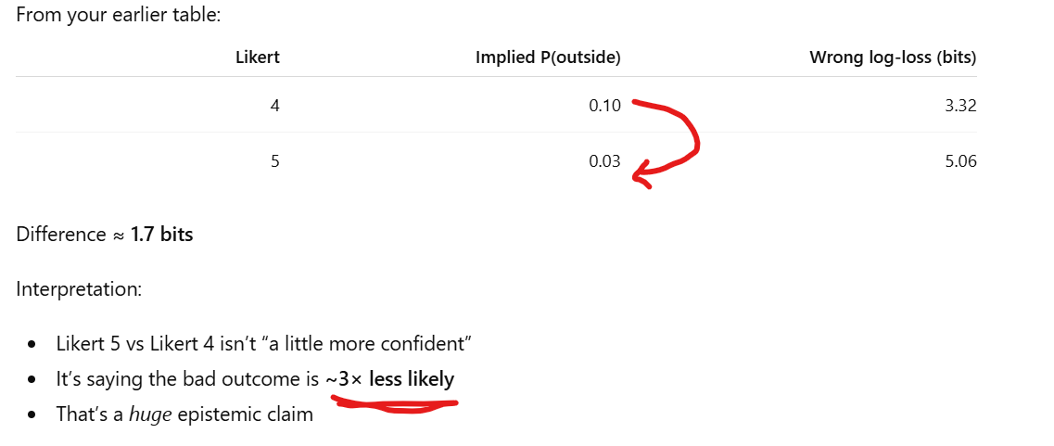
Is there really a difference between Likert anchors?

Slide 5
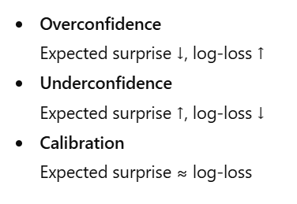
Log-loss (“how surprised you should be (objectively) by what actually happened, given your beliefs”) helps us define Diagnostic Calibration
Log-loss is outcome dependent: it does not punish you for failing to capture data. It punishes you for being surprised by the truth (incorrectness) and rewards accurate prediction (correctness) even if lucky.
Diagnostic Calibration is outcome-independent: it assesses if subjective confidence matches the real world state of unpredictability. It rewards hedging only when large surprise is expected.

Slide 6
Translating subjective surprisal states into implied P (px) and Log-loss (bits) – using log 2
Likert | Implied P (Ground Truth correct) | Implied P (Ground truth incorrect) | Log-loss if Correct (bits) | Log-loss if INCORRECT (bits)
1 | 0.50 | 0.50 | 1.000 | 1.000
2 | 0.35 | 0.65 | 0.621 | 1.515
3 | 0.20 | 0.80 | 0.322 | 2.322
4 | 0.10 | 0.90 | 0.152 | 3.322
5 | 0.03 | 0.97 | 0.044 | 5.059
But log-loss can also be calculated from actual probabilities in the case posterior distribution. This is the objective surprisal state based on information gathered. It also allows us to estimate the aleatoric limit…

Slide 7
Learner phenotypes
Overconfidn

Slide 8
Acute dizziness study
(160 UNMC M4s)
160 acutely dizzy sim patients (Chatbot as patient)
Chatbot says “woozy” rotating with “off kilter” and “dizzy” : ambiguous, unreliable character of dizziness (“maybe” motion)
Chatbot reports sensation of spinning, motion sickness, vertigo OR orthostasis : unambiguous character of dizziness
Reasoning traces:
  Appropriate management
    Can’t miss (“What’s lethal?”) : identifying red flag key features vs not
    Entropy reduction correlated with appropriate actions
      Unambiguous central gp should order MRI (SCT1a)
      Unambiguous peripheral vertigo gp should not order MRI (SCT2a)
    No one should be doing Dix-Hallpike in central sub-group (SCT1a, SCT2a)
    No one should be doing HINTS testing in peripheral sub-group (SCT1b, SCT2b)
  Script concordance tests
    Ambiguous central gp should perform HINTS testing or order MRI (SCT1a)
    Ambiguous peripheral gp should perform Dix-Hallpike & orthostatics (SCT 1b)
    Ambiguous orthostatic gp should order neurovest. rehab (SCT1b)
    Unambiguous orthostatic gp should not order neurovest. rehab (SCT2b)
    Unambiguous BPPV and Meniere’s gp should order neurovest. rehab (SCT2b)
Diagnostic Calibration
    Subjective: survey of “surprise”
    Objective: entropy removal in dx interview, log-loss, diagnostic accuracy
80 with semantic noise
(high entropy group)
80 with semantic signal
(low entropy group)
central
peripheral
central
peripheral
40 severe
> 24 hrs
+ Red flags
40 mild
< 60 minutes
No red flags
40 severe
> 24 hrs
+Red flags
40 mild
< 60 minutes
No red flags
CVA
N = 20
Vestibular neuritis
N = 20
CVA
N = 20
Vestibular neuritis
N = 20
Orthostatics
mildly negative
(equivocal)
no recent n/v/d
Orthostatics
unequivocally negative
no recent n/v/d
SCT 1a
SCT2a
Orthostatics
mildly positive
(equivocal)
N = 15
New recent BP medication + PD
Orthostatics
unequivocally positive
N = 15
New recent BP medication + PD
Hypotheses:
  Diagnostic accuracy will be greater in the low entropy group
  Higher measured entropy removal will be correlated with higher diagnostic accuracy and more appropriate uncertainty management across sub-groups (SCTs)
  Higher diagnostic calibration will be correlated with more appropriate uncertainty management (SCTs)
  Low diagnostic calibration phenotypes will be correlated with lower entropy removal per question asked
  High entropy group will ask more clarifying questions to better define the character and have more “angst” about the leading cause (if calibrated)
  Low entropy group will ask less questions about timing and triggers and have less “angst” about the leading cause (if calibrated)
BPPV
N = 15
Meniere’s
N = 10
BPPV
N = 15
Meniere’s
N = 10
SCT 1b:
SCT2b
SCT 1b
Entropy ddx removal schema calculations
SCT1a: central vs peripheral
SCT 1b: orthostatic vs non-orthostatic
SCT2a: central vs peripheral
SCT2b: orthostatic vs non-orthostatic

Slide 9
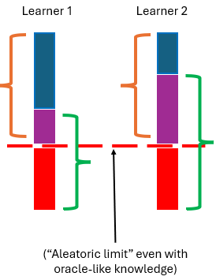
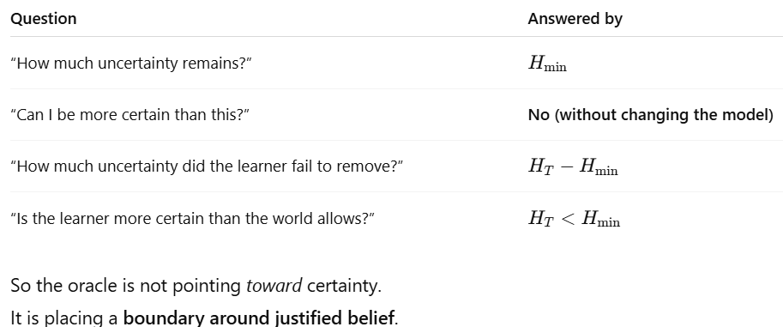
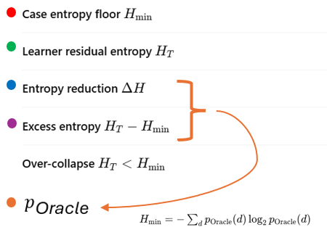
Log-loss calculation of the P_{oracle} distribution is an approximation of “how much surprise” is beneath the case entropy epistemic floor – an estimate of the aleatoric uncertainty.

Slide 10
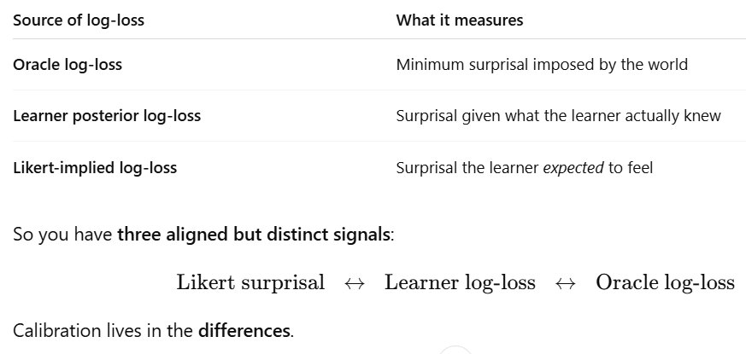
Summary of 3 measurable types of log-loss:
(Aleatoric limit)
(Objective learner)
(Subjective learner)

Slide 11
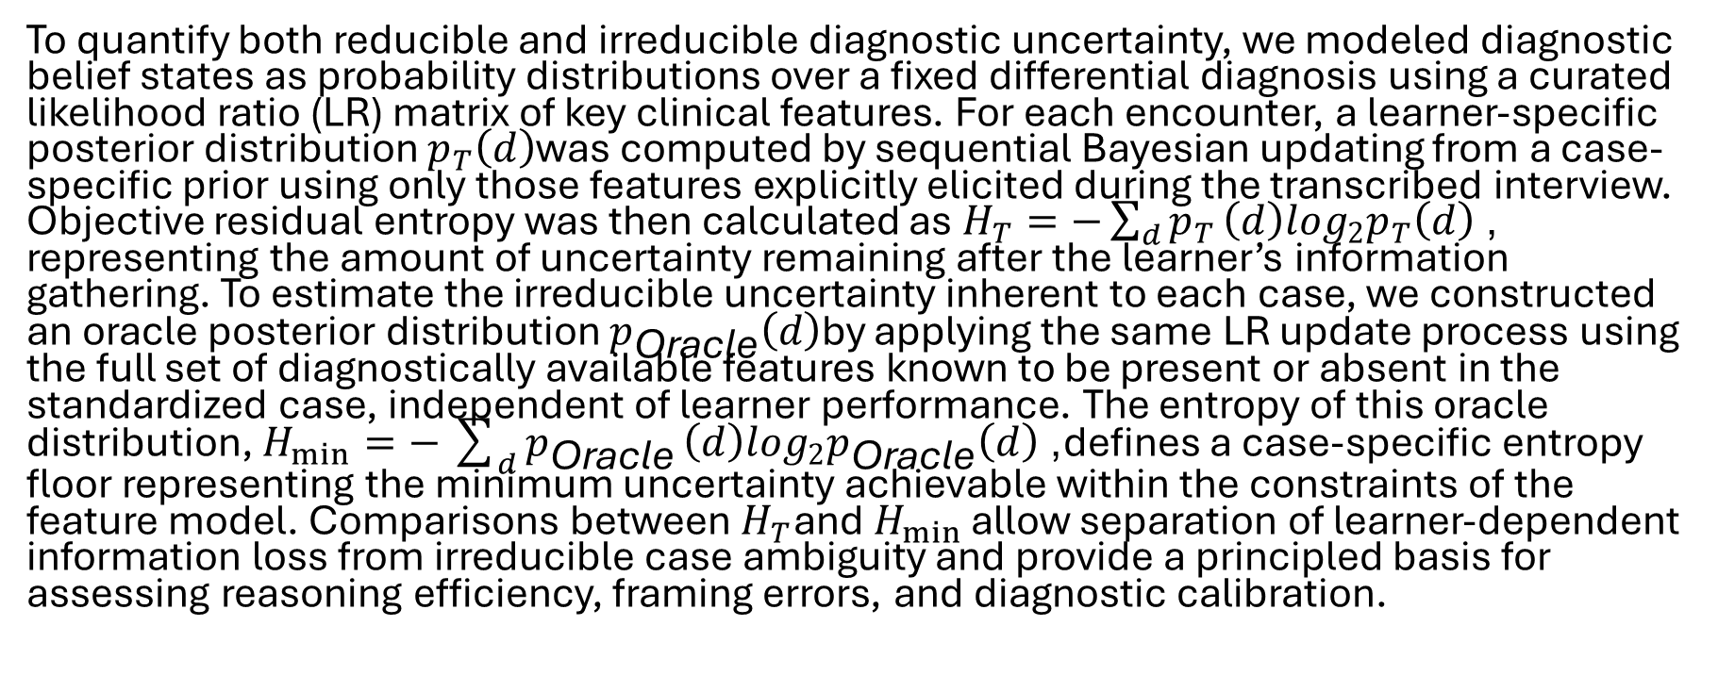
Methods: Objective Residual Entropy as a Case-Specific Entropy Floor (Aleatoric Uncertainty)
To quantify both reducible and irreducible diagnostic uncertainty, we modeled diagnostic belief states as probability distributions over a fixed differential diagnosis using a curated likelihood ratio (LR) matrix of key clinical features. For each encounter, a learner-specific posterior distribution $p_{T}\left(d\right)$was computed by sequential Bayesian updating from a case-specific prior using only those features explicitly elicited during the transcribed interview. Objective residual entropy was then calculated as $H_{T}=−\sum_{d}{p_{T}}\left(d\right)\log_{2}p_{T}\left(d\right)$, representing the amount of uncertainty remaining after the learner’s information gathering. To estimate the irreducible uncertainty inherent to each case, we constructed an oracle posterior distribution $p_{\text{Oracle}}\left(d\right)$by applying the same LR update process using the full set of diagnostically available features known to be present or absent in the standardized case, independent of learner performance. The entropy of this oracle distribution, $H_{min}=−\sum_{d}{p_{\text{Oracle}}}\left(d\right)\log_{2}p_{\text{Oracle}}\left(d\right)$, defines a case-specific entropy floor representing the minimum uncertainty achievable within the constraints of the feature model. Comparisons between $H_{T}$and $H_{min }$allow separation of learner-dependent information loss from irreducible case ambiguity and provide a principled basis for assessing reasoning efficiency, framing errors, and diagnostic calibration.

Slide 12
Diagnostic calibration
The study aims to quantify learners’ diagnostic calibration—the alignment between diagnostic confidence and diagnostic accuracy—by measuring the subjective experience of surprise when the final OSCE diagnosis differs from the learner’s stated differential. Surprise is the experiential signal of violated expectations and maps naturally onto information-theoretic constructs such as entropy and information gain. Emotion research consistently classifies surprise as a high-arousal state that is best captured through subjective intensity ratings. Decades of work conceptualize surprise as an emotion syndrome with four sub-components: a cognitive appraisal of unexpectedness, an experiential feeling of surprise, brief behavioral disruptions in processing (e.g., response delay), and expressive features such as eyebrow raising or jaw drop. For this study, we focus on the cognitive–experiential subcomponent most relevant to learners’ metacognitive judgment of diagnostic uncertainty. Reisenzein (2000) provides a well-validated framework for measuring this domain and identifies self-reported surprise intensity as the most direct and valid indicator, commonly operationalized with a 0–10 numeric scale. Because these measures were developed outside health professions education and our setting involves heightened emotional load in a summative OSCE, we adapted the validated structure into a context-specific 1–5 Likert scale with anchored descriptors to enhance clarity, reduce respondent burden, and support usable interpretation in educational research. This approach is further supported by Mauss and Robinson’s (2009) review of emotion measurement, which concludes that self-report is the primary validated method for assessing emotional states when physiological or expressive channels cannot be collected. Thus, the adapted Likert scale represents a theoretically grounded, empirically justified, and operationally feasible instrument for measuring learners’ anticipated surprise as an index of diagnostic calibration.

Slide 13
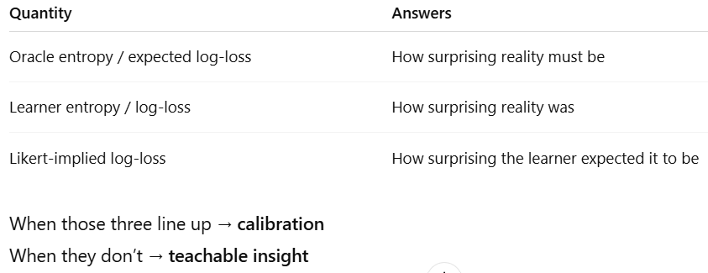
Operationalizing this framework for clinician educator coaching:

Slide 14
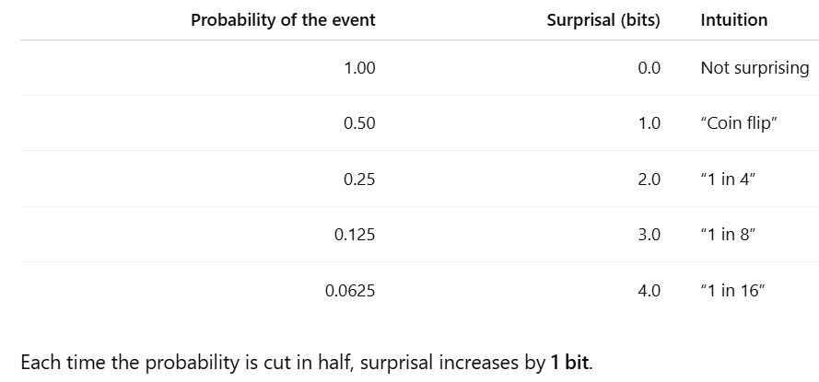
It’s pedagogically useful to measure calibration in bits because we already think in these terms, “it’s twice as likely as that”
In other words, Bits let you talk about confidence errors in exactly the same language.
  A 1-bit increase in surprisal corresponds to the event being half as probable.
  A 1-bit decrease corresponds to the event being twice as probable.

Slide 15
Measuring calibration of individual clinicians
Hypothesis: Advanced diagnosticians will be more calibrated than novices
Challenge: Measuring the interviewer’s subjective level of certainty in their diagnostic refinement when there are multiple, off-target, contextual drivers of a learner’s emotional states
Epistemic Emotion | Imposter syndrome (low confidence individual independent of context) | Relational driver of angst (“this is my preceptor’s patient… I don’t want to screw up”) | Clinical stakes (“life / death decisions”) | Impression management (“gaming the test”) | Perceived missed opportunities to firm up the working dx (“I should’ve asked about this…”)
Confidence | xxx | x | x | xxx | x
Certainty | xxx | x | x | xxx | x
Uncertainty | xxx | x | x | xxx | x
Angst | x | xxx | xxx | x | x
Unsettled | x | xxx | xxx | x | ?
Surprise | ? | ? | ? | ? | ?
Regret | ? | xxx | xxx | ? | xxx
Q1) How surprised would you be if the final diagnosis ended up being something other than what you’ve listed on the differential diagnosis?
Q2) How much will you be ruminating about various possibilities in this patient tonight?
Q2) If an unexpected diagnosis were to become apparent, would you feel any regret about missed opportunities to firm up the initial working diagnosis?

Slide 16
How do implied probabilities (implied P) from a subjective Likert scale help us measure anticipated surprise?
Implied P is an input to the output of subjective Log-loss.
Log loss is a quantitative score that asks, “how surprised should you be by what actually happened, given your beliefs?”

